Slide 1
State Incentive Grant (SPF SIG) City of Redlands 2nd Planning Meeting
January 22, 2013
Rick McGaffigan, MSW - PRC

Slide 2
Introductions
Notes:
Go around room, Name, agency,

Slide 3
Overview of the Day
Review of Logic Models
Overview of DoView
Underage Drinking Model
Alcohol-related Crashes Model
Intervention Component Planning
Enforcement
Visibility
Calendar planning
Next Steps

Slide 4
Underage Drinking: Basic Research
Evidence: Population Prevention Effects
Strong
Moderate
Low (target group only)
None (no target or population)
Visible Enforcement
Retail Availability of Alcohol to Youth
Price
Alcohol-Related Problems
(Traffic crashes, Injuries,
School performance. Unsafe sex, Violence, etc.)
Social Availability of Alcohol to Youth
Underage Drinking Laws
Underage Drinking
Drinking Beliefs
Community Norms About Youth
Drinking
Family, School, and Peer Influence
Drinking Context
Alcohol Promotion (Advertising, Point of Sale Promotion , Sponsorship of Community Events)

Slide 5
Reward & Reminder
Retail Serving Practices
Decoy Operations
Nuisance Party Patrols
Social Host Liability
DUI Enforcement

Slide 6
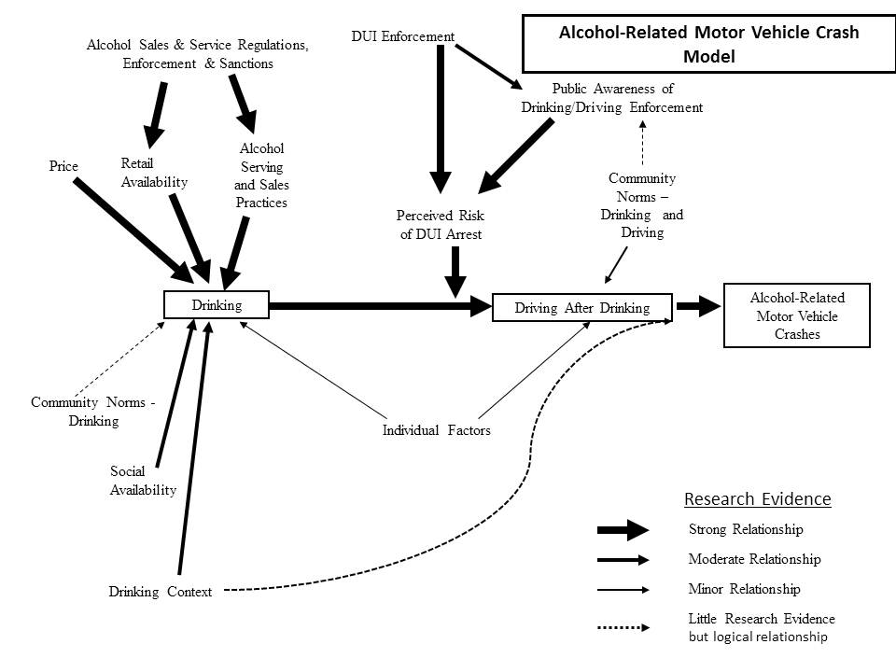

Slide 7
DUI Enforcement
Retail Serving Practices
Nuisance Party Patrols
Social Host Liability

Slide 8
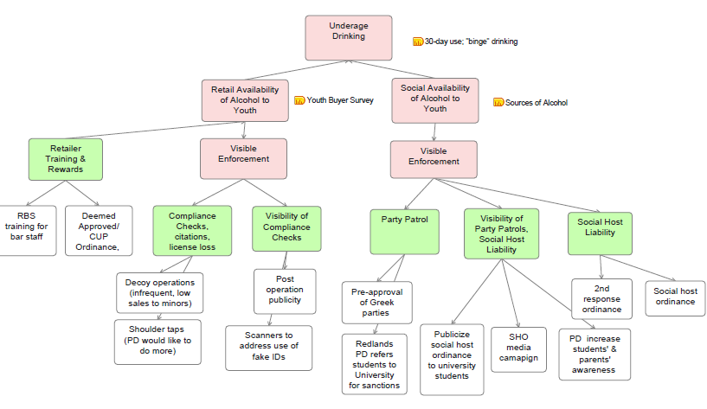

Slide 9
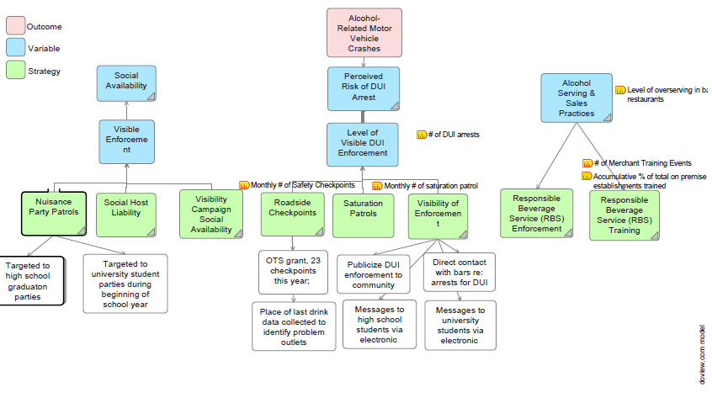

Slide 10
Action Plan Considerations
Targeting times:
Targeting places:
Focus of intervention:
Data needed to mobilize support:
Using logic models for EBP:
Tied to continuous monitoring and improvement:

Slide 11
Social Availability Policies: Social Host Ordinance (passed) Second Response Ordinance
Private Parties (High School)
Component | Focus | Lead Person | Team Members | Intervention Calendar Planning
Enforcement
Nuisance party patrols (resources) | Private party host/parents Target graduation time |  |  | Spring – Prom and graduation
DUI enforcement | Roadside checkpoints OTS – 23 Saturation patrols |  |  | 1. 2.
Social Host Ordinance | Roll out ordinance to community
Visibility
Audience | PD – high schools (students and parents) Community
Message development | Media campaign by IPS to promote SHO POLD (data)
Placement | Electronic media to HS students
Timely | Align with enforcement for deterrent effect

Slide 12
Next Steps

